Slide 1

Basic
Integrated Circuit
Function
BD7F100EFJ
Comparator Adaptive On-Time Controller
Driver
N-Channel MOSFET
SW output
Panagiotis Rigas

Slide 2

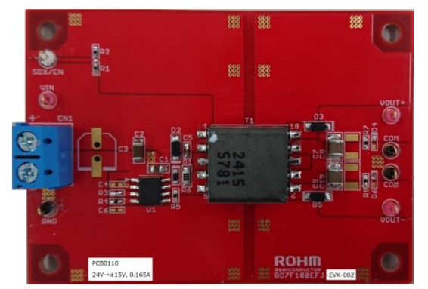
PCB size: 70mm x 50mm x 1.6mm
Closed loop Flyback Converter – Feedback from output to the input – thus the output is regulated
Feedback Loop – Detects the secondary side voltage and current from the primary side – Creates a simple PP using only transformer and passive components – Further simplifies designs and reduces parts count
Figure 1. BD7F100EF-EVK-002 Evaluation Board Top View
Basic Principles of Power Electronics
Supervisor: Professor Nikolaos Papanikolaou

Slide 3
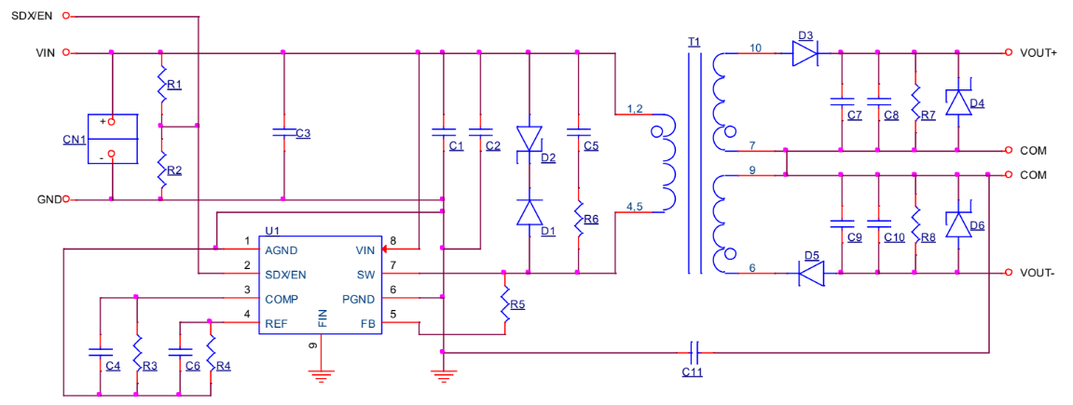
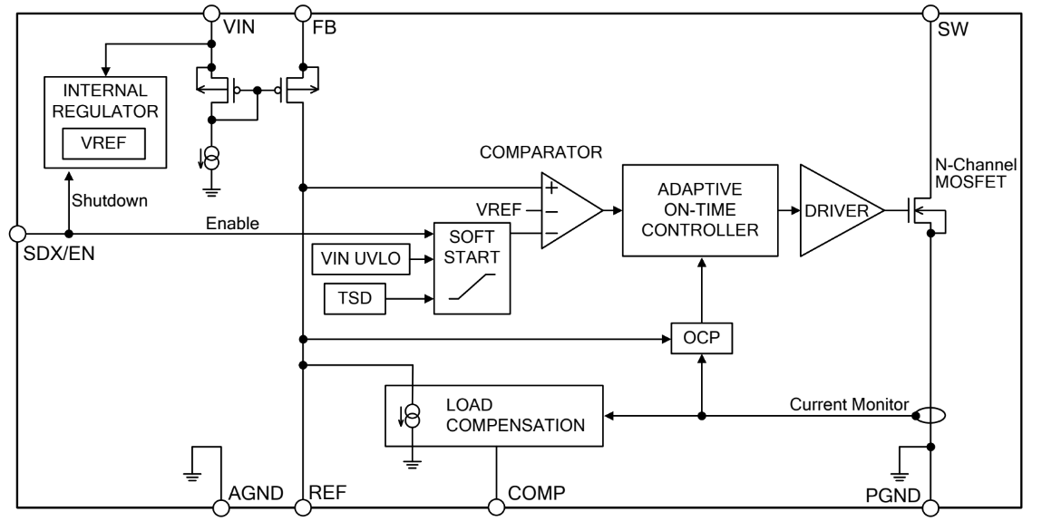
Figure 1. BD7F100EF-EVK-002 Circuit Diagram
Figure 1. BD7F100EF-EVK-002-U1 Block Diagram
$$V_{IN}=24 V, V_{OUT1}=15V,{ V}_{OUT2}=−15V$$
COMPARATOR
The block which compares the reference voltage with the REF terminal voltage, which is the feedback voltage
Basic Principles of Power Electronics
Supervisor: Professor Nikolaos Papanikolaou
Notes:
https://www.digikey.be/en/articles/reduce-design-complexity-integrated-isolated-flyback-converters
https://www.accessengineeringlibrary.com/content/book/9780071482721/chapter/chapter12
http://pep.ijieee.org.in/journal_pdf/11-140-1434187363111-114.pdf
https://www.engineersgarage.com/electronic-projects/designing-open-loop-isolated-flyback-converter-part-11-12/

Slide 4
ADAPTIVE ON-TIME CONTROLLER
This is the block corresponding to the original adapted type ON-Time control technology.
Switching frequency is fixed at 400kHz (Typ) under PWM Control when the load is stable.
Under On-Time Control, when the load varies, fast load response is enabled by changing the switching frequency.
During light load, the highly efficient PFM will operate and the self-power dissipation is suppressed by decreasing the
switching frequency.
Figure 1. BD7F100EF-EVK-002-U1 Block Diagram
DRIVER
This is the block which drives the built-in N-Channel MOSFET.
Basic Principles of Power Electronics
Supervisor: Professor Nikolaos Papanikolaou
Notes:
https://www.digikey.be/en/articles/reduce-design-complexity-integrated-isolated-flyback-converters
https://www.accessengineeringlibrary.com/content/book/9780071482721/chapter/chapter12
http://pep.ijieee.org.in/journal_pdf/11-140-1434187363111-114.pdf
https://www.engineersgarage.com/electronic-projects/designing-open-loop-isolated-flyback-converter-part-11-12/

Slide 5
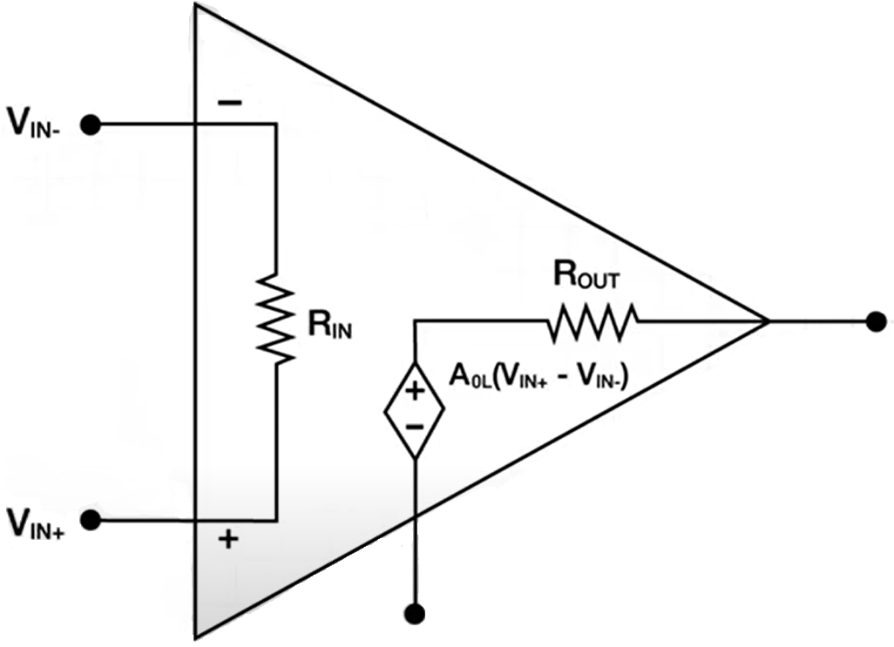
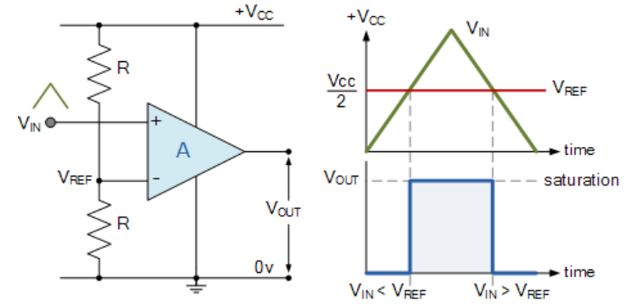
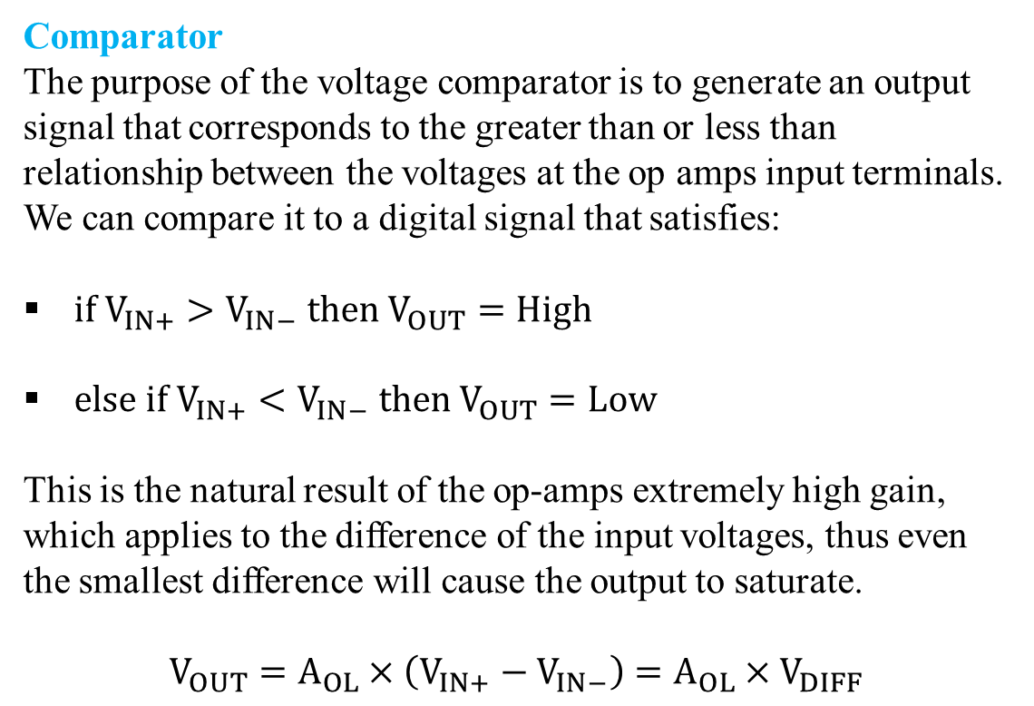
Comparator
The purpose of the voltage comparator is to generate an output signal that corresponds to the greater than or less than relationship between the voltages at the op amps input terminals. We can compare it to a digital signal that satisfies:
$if V_{IN+}>V_{IN−} then V_{OUT}=High$
$else if V_{IN+}<V_{IN−} then V_{OUT}=\text{Low}$
This is the natural result of the op-amps extremely high gain, which applies to the difference of the input voltages, thus even the smallest difference will cause the output to saturate.
$$V_{OUT}=A_{OL}×\left(V_{IN+}−V_{IN−}\right)=A_{OL}×V_{DIFF}$$
Basic Principles of Power Electronics
Supervisor: Professor Nikolaos Papanikolaou
Notes:
https://www.youtube.com/watch?v=MlDYP34FsMs

Slide 6
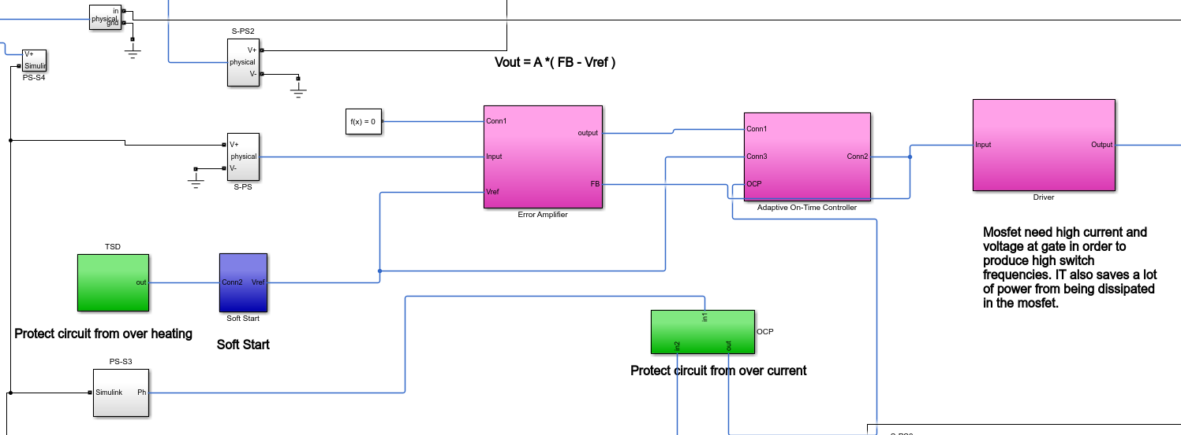
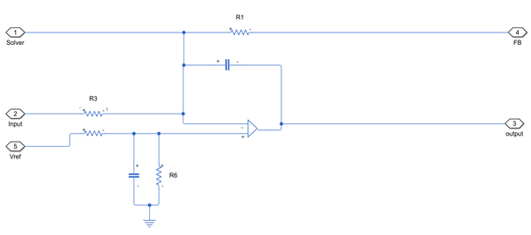
Error Amplifier
The error amplifier accommodates feedback of the output PWM waveform in order to correct for any errors in the output voltage introduced by the comparator
By including the comparator in the feedback loop of the amplifier and adding integration capacitor, the error amplifier now directly controls the average output voltage. The power supply voltage of the comparator does not affect the average output voltage.
Selecting Values:
By adjusting R1 and R3 we get the expected gain
Choose integration capacitor to limit the bandwidth of the error amplifier to below the switching frequency in order to ensure stability of the system
Choose R6 and Rref to balance gain
Basic Principles of Power Electronics
Supervisor: Professor Nikolaos Papanikolaou
Notes:
https://www.digikey.be/en/articles/reduce-design-complexity-integrated-isolated-flyback-converters
https://www.accessengineeringlibrary.com/content/book/9780071482721/chapter/chapter12
http://pep.ijieee.org.in/journal_pdf/11-140-1434187363111-114.pdf
https://www.engineersgarage.com/electronic-projects/designing-open-loop-isolated-flyback-converter-part-11-12/

Slide 7
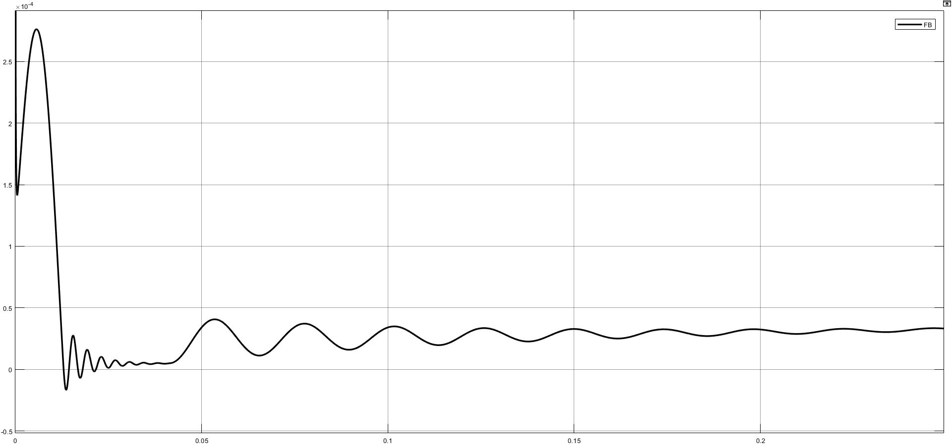
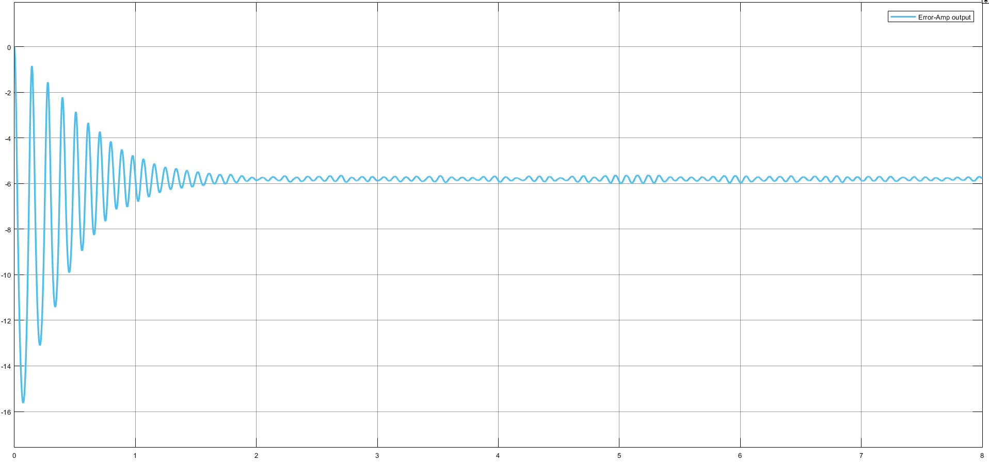
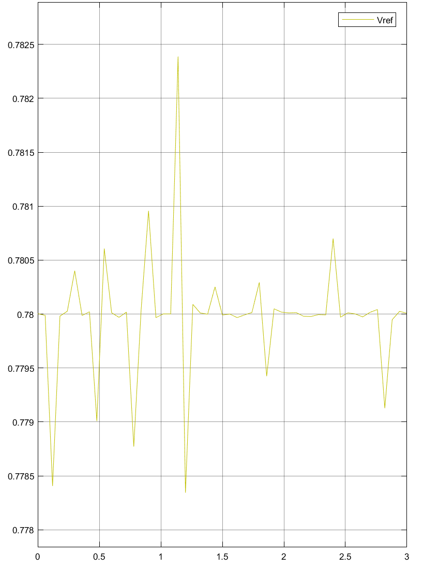
Basic Principles of Power Electronics
Supervisor: Professor Nikolaos Papanikolaou
Notes:
https://www.youtube.com/watch?v=MlDYP34FsMs

Slide 8
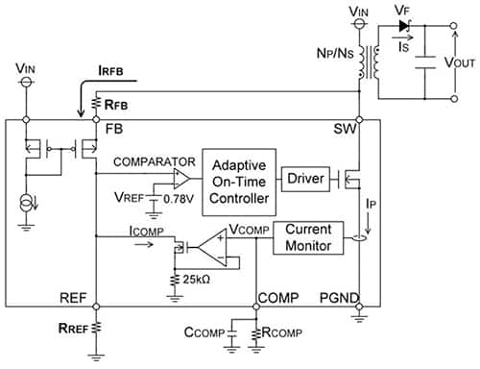
Adaptive On-Time Controller
Traditional flyback converter designs typically use an error amplifier to correct their output voltage. In contrast, the BD7F series uses an approach called adaptive ON-Time control that is based on a comparator. During operation, the circuit determines ON and OFF times by comparing its internal reference voltage with the feedback voltage monitored at its SW terminal
series adaptive ON-Time controller relies on a comparator that senses primary side feedback voltage to adjust switch duty-cycle as needed to maintain a stable output voltage.
Figure 1. BD7F100EF-EVK-002-U1 Block Diagram
Basic Principles of Power Electronics
Supervisor: Professor Nikolaos Papanikolaou
Notes:
https://www.digikey.be/en/articles/reduce-design-complexity-integrated-isolated-flyback-converters
https://www.accessengineeringlibrary.com/content/book/9780071482721/chapter/chapter12
http://pep.ijieee.org.in/journal_pdf/11-140-1434187363111-114.pdf
https://www.engineersgarage.com/electronic-projects/designing-open-loop-isolated-flyback-converter-part-11-12/

Slide 9
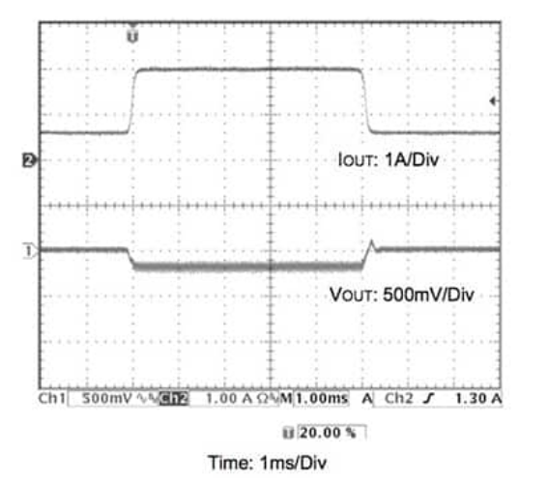
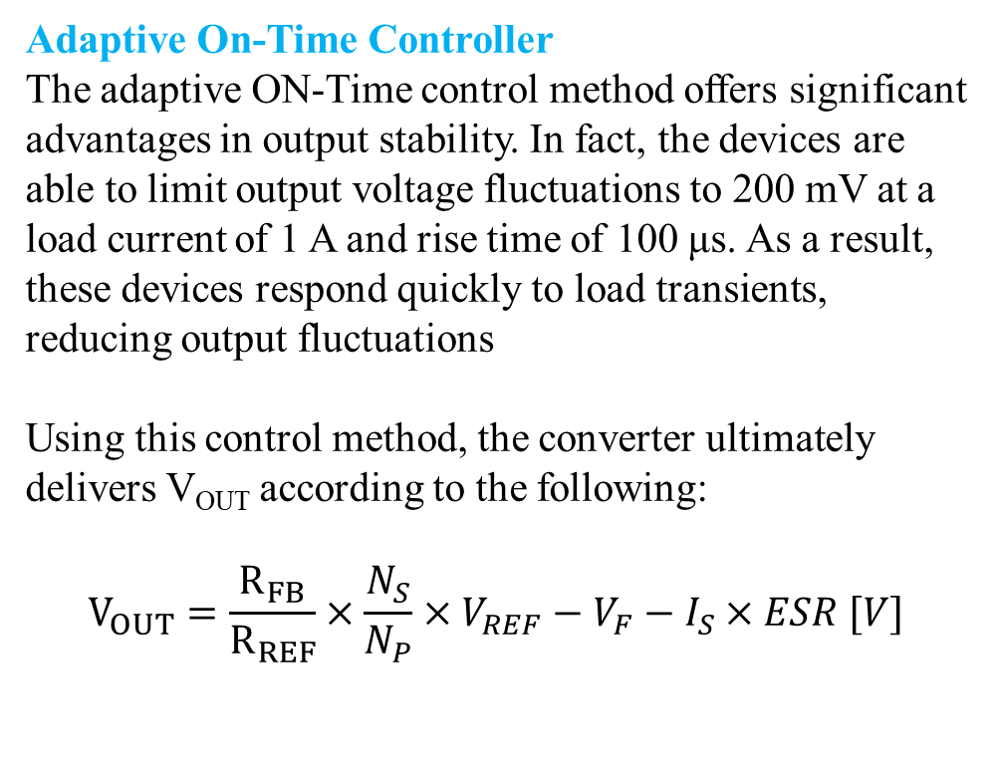
Adaptive On-Time Controller
The adaptive ON-Time control method offers significant advantages in output stability. In fact, the devices are able to limit output voltage fluctuations to 200 mV at a load current of 1 A and rise time of 100 μs. As a result, these devices respond quickly to load transients, reducing output fluctuations
Using this control method, the converter ultimately delivers V_{OUT} according to the following:
$$V_{OUT}=\frac{R_{FB}}{R_{REF}}×\frac{N_{S}}{N_{P}}×V_{REF}−V_{F}−I_{S}×ESR [V]$$
Figure 1: The adaptive ON-Time control method used in the ROHM BD7F isolated converters helps ensure that output voltage fluctuations (lower waveform) are limited to about 200 mV during load transients (upper waveform).
Basic Principles of Power Electronics
Supervisor: Professor Nikolaos Papanikolaou
Notes:
where
R_{FB} is the external resistance between the FB-SW terminals
R_{REF} is the external resistance between the REF–AGND terminals
N_{P} is the number of turns in the transformer primary side
N_{S} is the number of turns in the transformer secondary side
V_{REF} is the REF terminal voltage
V_{F} is the forward voltage VF of the output diode
I_{S} is secondary transformer current
ESR is the total impedance in the secondary side

Slide 10
Adaptive On-Time Controller
A notable result illustrated in this equation is that you can in part set the output voltage by choosing the appropriate primary and secondary turns ratio of the transformer, and by adjusting the ratio of the resistances R_{FB} and R_{REF}.
The equation further illustrates that the output voltage level is also subject to an output voltage error determined by V_{F} and ESR. This error can be reduced by selecting a Schottky barrier diode with a small V_{F}. The ESR, however, is more difficult to control as it is the total impedance in the secondary side, which includes the transformer wirewound resistance and the pc board impedance.
Even with optimal diode selection and careful ESR management, it is possible to have an output voltage error in your application, which in turn can lead to poor load regulation. To reduce the effect of these inherent error sources, BD7F devices are designed with an internal load compensation function that can significantly improve output regulation across the device's output current range.
Basic Principles of Power Electronics
Supervisor: Professor Nikolaos Papanikolaou
Notes:
https://www.digikey.be/en/articles/reduce-design-complexity-integrated-isolated-flyback-converters
https://www.accessengineeringlibrary.com/content/book/9780071482721/chapter/chapter12
http://pep.ijieee.org.in/journal_pdf/11-140-1434187363111-114.pdf
https://www.engineersgarage.com/electronic-projects/designing-open-loop-isolated-flyback-converter-part-11-12/

Slide 11
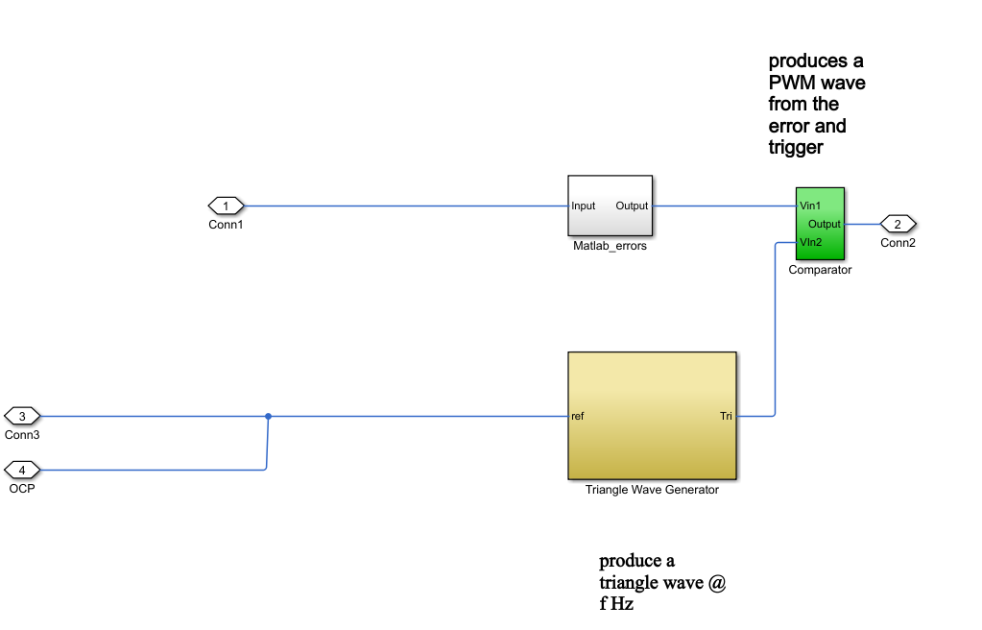
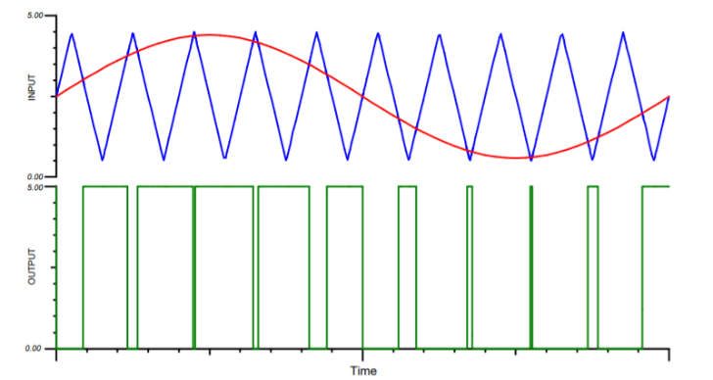
PWM generator
This circuit utilizes a triangle wave generator and comparator to generate a pulse-width-modulated (PWM) waveform with a duty cycle that is inversely proportional to the input voltage.
An op amp and comparator generate a triangular waveform which is passed to the inverting input of a second comparator. By passing the input voltage to the non-inverting comparator input, a PWM waveform is produced.
Negative feedback of the PWM waveform to an error amplifier is utilized to ensure high accuracy and linearity of the output
Basic Principles of Power Electronics
Supervisor: Professor Nikolaos Papanikolaou
Notes:
where
R_{FB} is the external resistance between the FB-SW terminals
R_{REF} is the external resistance between the REF–AGND terminals
N_{P} is the number of turns in the transformer primary side
N_{S} is the number of turns in the transformer secondary side
V_{REF} is the REF terminal voltage
V_{F} is the forward voltage VF of the output diode
I_{S} is secondary transformer current
ESR is the total impedance in the secondary side

Slide 12
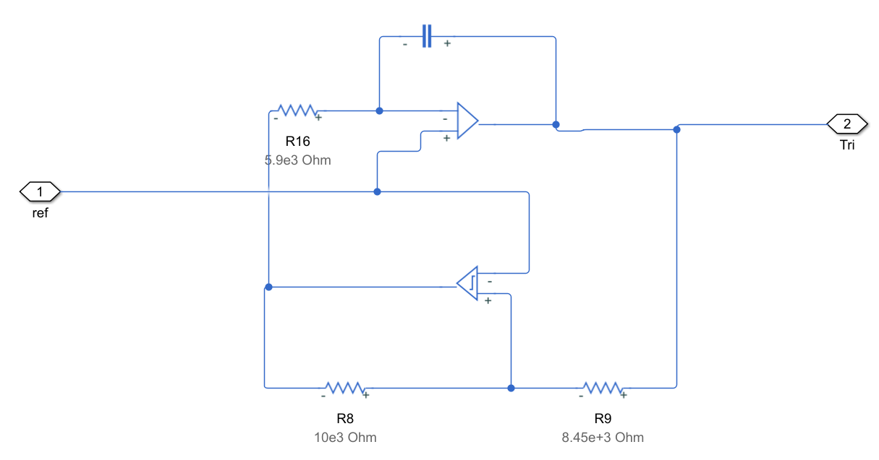
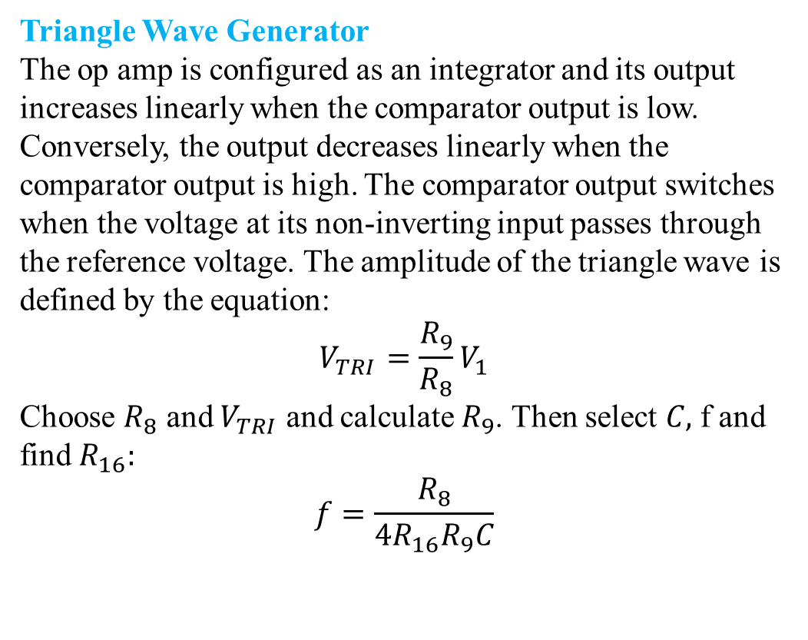
Triangle Wave Generator
The op amp is configured as an integrator and its output increases linearly when the comparator output is low. Conversely, the output decreases linearly when the comparator output is high. The comparator output switches when the voltage at its non-inverting input passes through the reference voltage. The amplitude of the triangle wave is defined by the equation:
$$V_{TRI}=\frac{R_{9}}{R_{8}}V_{1}$$
Choose $R_{8}$ and $V_{TRI}$ and calculate $R_{9}$. Then select $C,$ f and find $R_{16}:$
$$f=\frac{R_{8}}{4R_{16}R_{9}C}$$
Basic Principles of Power Electronics
Supervisor: Professor Nikolaos Papanikolaou
Notes:
Choose the nearest impedance

Slide 13
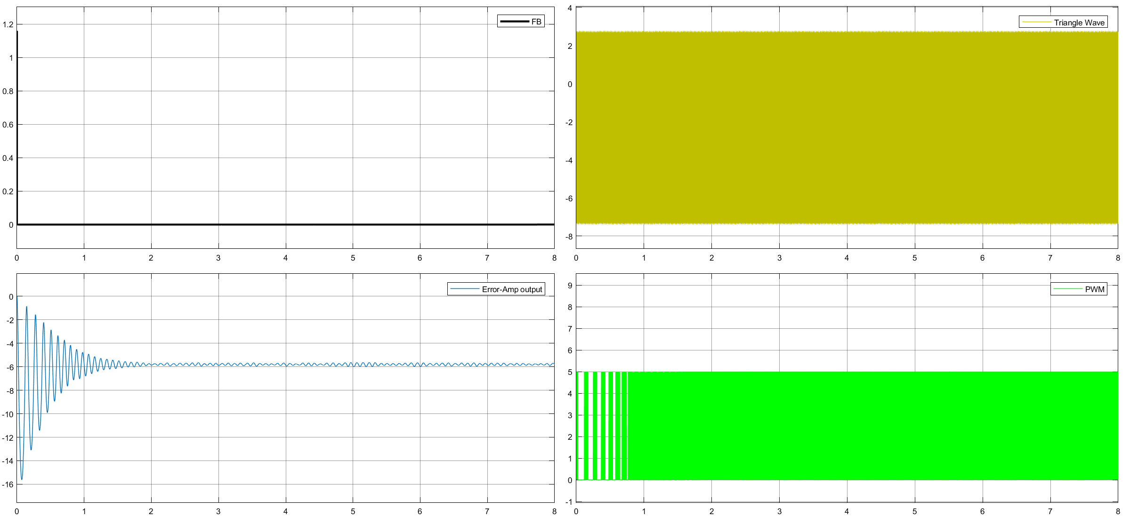
Basic Principles of Power Electronics
Supervisor: Professor Nikolaos Papanikolaou
Notes:
Choose the nearest impedance

Slide 14
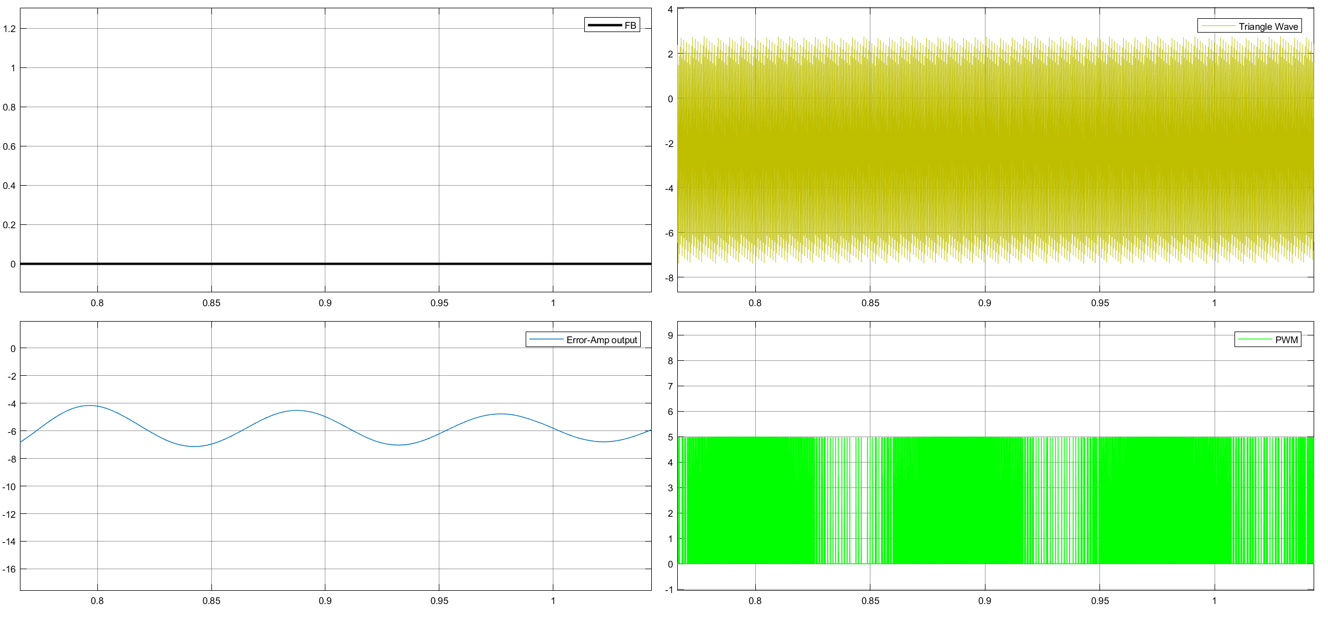
Basic Principles of Power Electronics
Supervisor: Professor Nikolaos Papanikolaou
Notes:
Choose the nearest impedance

Slide 15
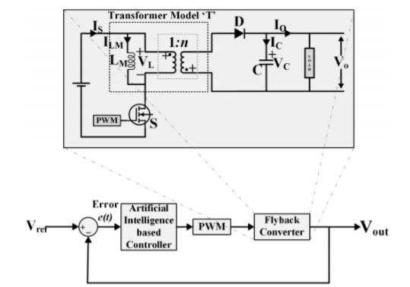
Alternative Controllers for DC-DC Flyback Converter
The controller usually applied in PWM switching control is the Proportional-Integral-Differential (PID), praised for its simplicity. However, it produces long rise time when the overshoot in output voltage decreases. As a solution several Intelligence controller such as fuzzy logic, neural network and hybrid neuro-fuzzy control methods for DC-DC have been implemented.
NNCs minimize the difference between the output voltage and the reference voltage. In addition, the dynamic characteristics of dc-dc converter are improved and can realize excellent dynami characteristics with the used of neural network, as compare with the conventional PID method
Basic Principles of Power Electronics
Supervisor: Professor Nikolaos Papanikolaou
Notes:
Article Artificial Intelligence-Based Controller for DC-DC Flyback Converter Muhammad Arslan Shahid 1 , Ghulam Abbas 1,* , Mohammad Rashid Hussain 2 , Muhammad Usman Asad 3 , Umar Farooq 3,4 , Jason Gu 3 , Valentina E. Balas 5 , Muhammad Uzair 6 , Ahmed Bilal Awan 7 and Tanveer Yazdan
Voltage Tracking of a DC-DC Flyback Converter Using Neural Network Control W.M.Utomo, S.S. Yi, Y.M.Y Buswig, Z.A. Haron, A. A. Bakar and M. Z. Ahmad Faculty of Electrical and Electronic Engineering, Universiti Tun Hussein Onn Malaysia e-mail: wahyu@uthm.edu.my

Slide 16
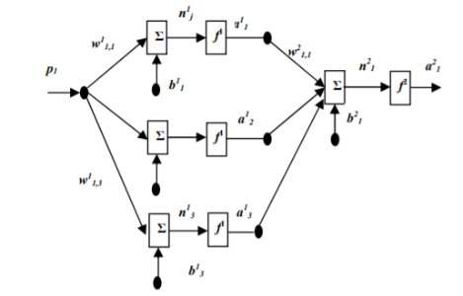
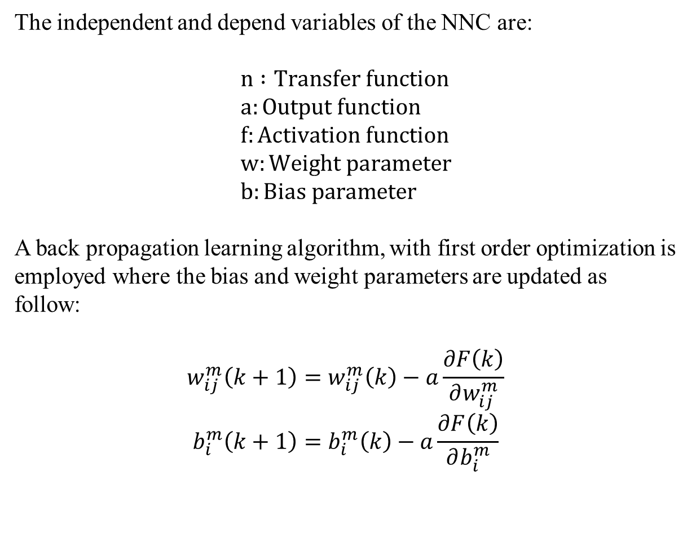
Neural Network Control
The independent and depend variables of the NNC are:
$$n :Transfer function \\ a:Output function \\ f:Activation function \\ w:Weight parameter \\ b:Bias parameter$$
A back propagation learning algorithm, with first order optimization is employed where the bias and weight parameters are updated as follow:
$$w_{ij}^{m}\left(k+1\right)=w_{ij}^{m}\left(k\right)−a\frac{∂F\left(k\right)}{∂w_{ij}^{m}}$$
$$b_{i}^{m}\left(k+1\right)=b_{i}^{m}\left(k\right)−a\frac{∂F\left(k\right)}{∂b_{i}^{m}}$$
Figure 1. The architecture of the NNC is given. The network has a 1-3-1 neurons structure
Basic Principles of Power Electronics
Supervisor: Professor Nikolaos Papanikolaou
Notes:
The training
process minimizes the error output of the network through an optimization method. Generally, in learning
mode of the neural network controller a sufficient training data input-output mapping data of a plant is required.

Slide 17

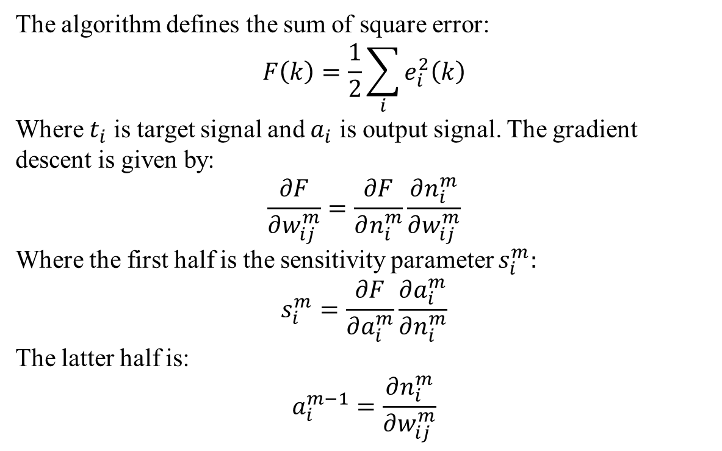
The algorithm defines the sum of square error:
$$F\left(k\right)=\frac{1}{2}\sum_{i}{e_{i}^{2}\left(k\right)}$$
Where $t_{i}$ is target signal and $a_{i}$ is output signal. The gradient descent is given by:
$$\frac{∂F}{∂w_{ij}^{m}}=\frac{∂F}{∂n_{i}^{m}}\frac{∂n_{i}^{m}}{∂w_{ij}^{m}}$$
Where the first half is the sensitivity parameter $s_{i}^{m}:$
$$s_{i}^{m}=\frac{∂F}{∂a_{i}^{m}}\frac{∂a_{i}^{m}}{∂n_{i}^{m}}$$
The latter half is:
$$a_{i}^{m−1}=\frac{∂n_{i}^{m}}{∂w_{ij}^{m}}$$
Neural Network Control
Figure 1. The architecture of the NNC is given. The network has a 1-3-1 neurons structure
The new connection weight and bias parameters are given by:
$$w_{ij}^{m−1}\left(k+1\right)=w_{i}^{m−1}\left(k\right)−as_{i}^{m}\left(k\right)a_{i}^{m−1}\left(k\right) \\ b_{i}^{m−1}\left(k+1\right)=b_{i}^{m−1}\left(k\right)−as_{i}^{m}(k)$$
Basic Principles of Power Electronics
Supervisor: Professor Nikolaos Papanikolaou
Notes:
The training
process minimizes the error output of the network through an optimization method. Generally, in learning
mode of the neural network controller a sufficient training data input-output mapping data of a plant is required.

Slide 18
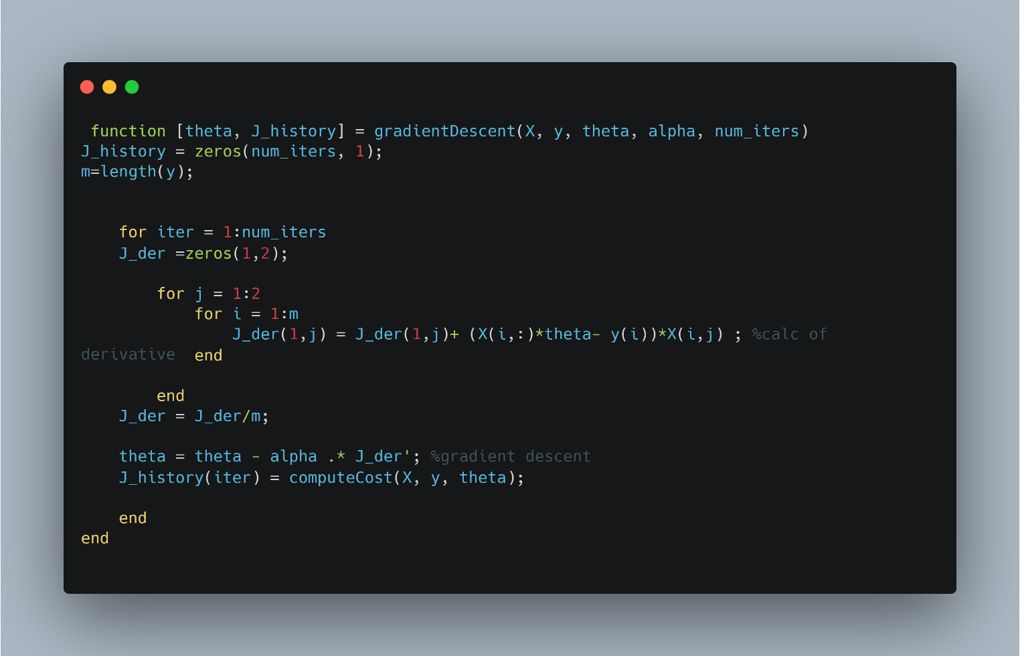
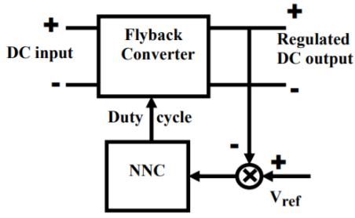
Neural Network Control
Figure 1. Block diagram of NNC control of Flyback converter and gradient descent matlab implementation
Basic Principles of Power Electronics
Supervisor: Professor Nikolaos Papanikolaou
Notes:
The training
process minimizes the error output of the network through an optimization method. Generally, in learning
mode of the neural network controller a sufficient training data input-output mapping data of a plant is required.

Slide 19
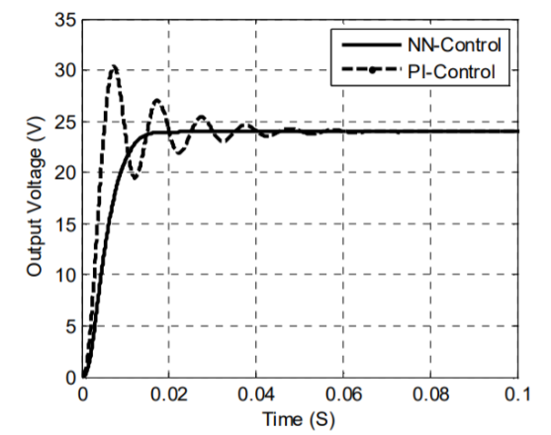
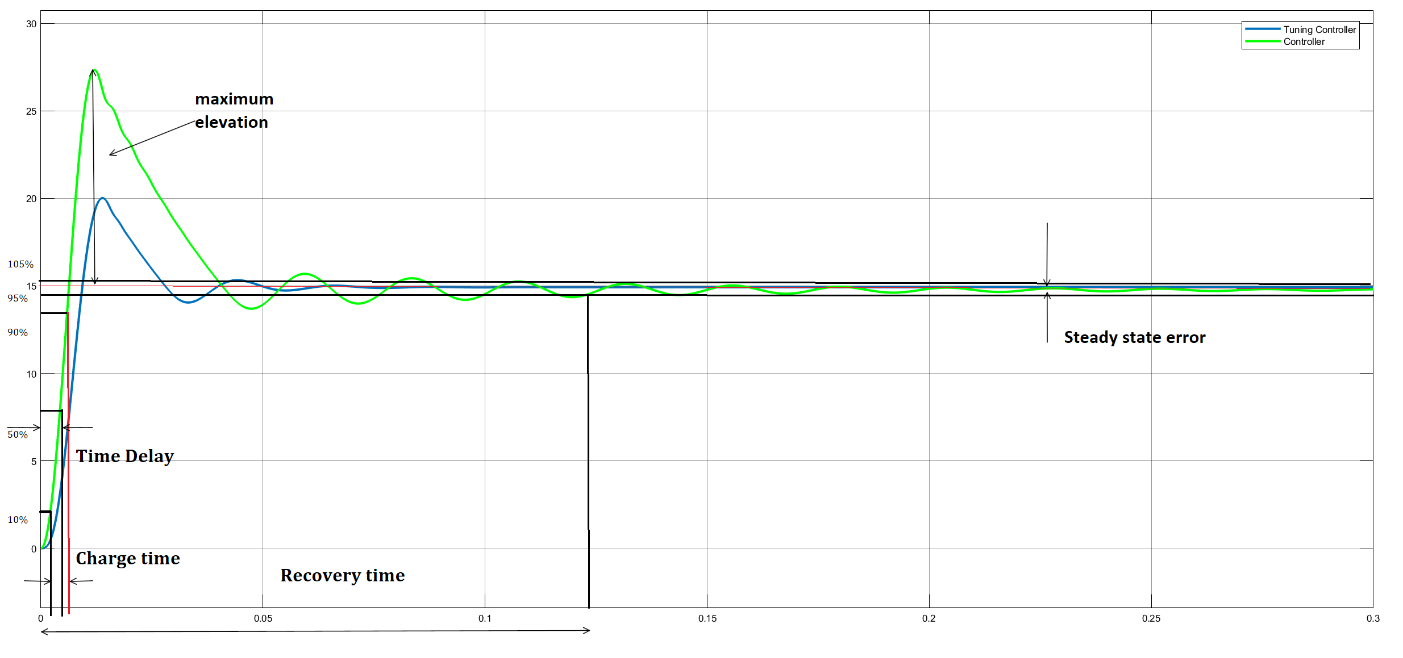
Neural Network Control
It is observable that the NNC block is effective in decreasing
Overshoot and reducing settling time
Figure 1. output voltage
Basic Principles of Power Electronics
Supervisor: Professor Nikolaos Papanikolaou
Notes:
The training
process minimizes the error output of the network through an optimization method. Generally, in learning
mode of the neural network controller a sufficient training data input-output mapping data of a plant is required.

Slide 20
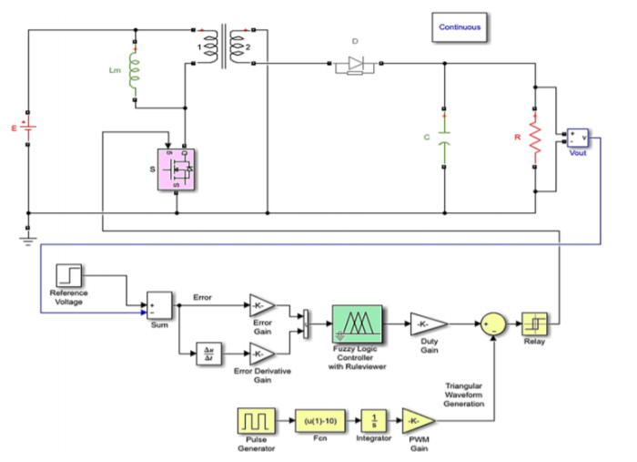
Fuzzy Logic and Adaptive neuro-fuzzy inference system
The output voltage is measured and is compared with the reference value, and thus, an error is generated. Two quantities, namely error e and derivative of the error ∆e, are generated as the inputs for the fuzzy logic controller.
The fuzzy logic controller processes the quantities based on membership functions (MFs) and fuzzy rules to generate an output, which is the duty cycle d.
This signal is compared with a triangular waveform
to generate duty cycle pulses for the gate of mosfet.
Figure 1. FC model with FLC in MATLAB/Simulink.
Basic Principles of Power Electronics
Supervisor: Professor Nikolaos Papanikolaou
Notes:
The training
process minimizes the error output of the network through an optimization method. Generally, in learning
mode of the neural network controller a sufficient training data input-output mapping data of a plant is required.

Slide 21
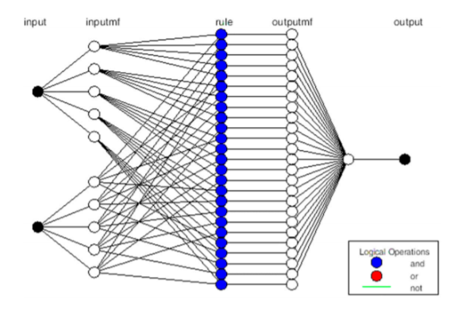
Fuzzy Logic and Adaptive neuro-fuzzy inference system
ANFIS is the combination of FL and NN. It uses NN to adjust the parameters, reducing the error. It applies a hybrid learning algorithm, the combination of back-propagation and least-squares error algorithms. Its structure is similar to NN. Notes can be adaptive or fixed.
Figure 1. ANFIS architecture
Basic Principles of Power Electronics
Supervisor: Professor Nikolaos Papanikolaou
Notes:
Layer 1 4 adaptive notes
Layer 2 3 fixed

Slide 22
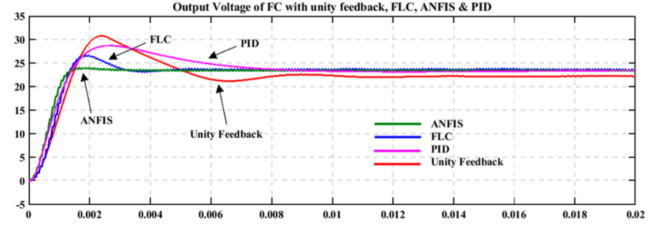
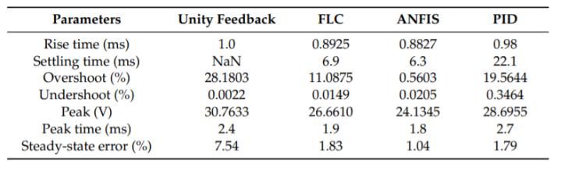
Fuzzy Logic and Adaptive neuro-fuzzy inference system
FC,FLC,ANFIS and PID controllers are being monitored. The results are summarized in the following table:
Figure 1. output voltage of FC, FLC, ANFIS and PID controllers
Basic Principles of Power Electronics
Supervisor: Professor Nikolaos Papanikolaou
Notes:
To keep the output voltage of an FC system regulated as necessary for modern electronic devices irrespective of the changes in input voltage or load current, an ANFIS-based controller was proposed in this research.
A FIS structure containing 25 fuzzy rules (in our case) relating the inputs and the output originally generated by the fuzzy logic system was tuned by ANFIS.
It was observed that the FIS tuned by ANFIS exhibited better output voltage response under static and transient loads. Better set-point tracking was also achieved. ANFIS may utilize past results or experiences to make immediate decisions about the response. Training of fuzzy rules by ANFIS made the ANFIS-based controller more adaptive. Simulation results depicted that both the static and dynamic performance of the ANFIS-based controller was better in all aspects compared to the FLC and PID controllers. Hardware implementation of the proposed compensated system can be carried out in future.

Slide 23
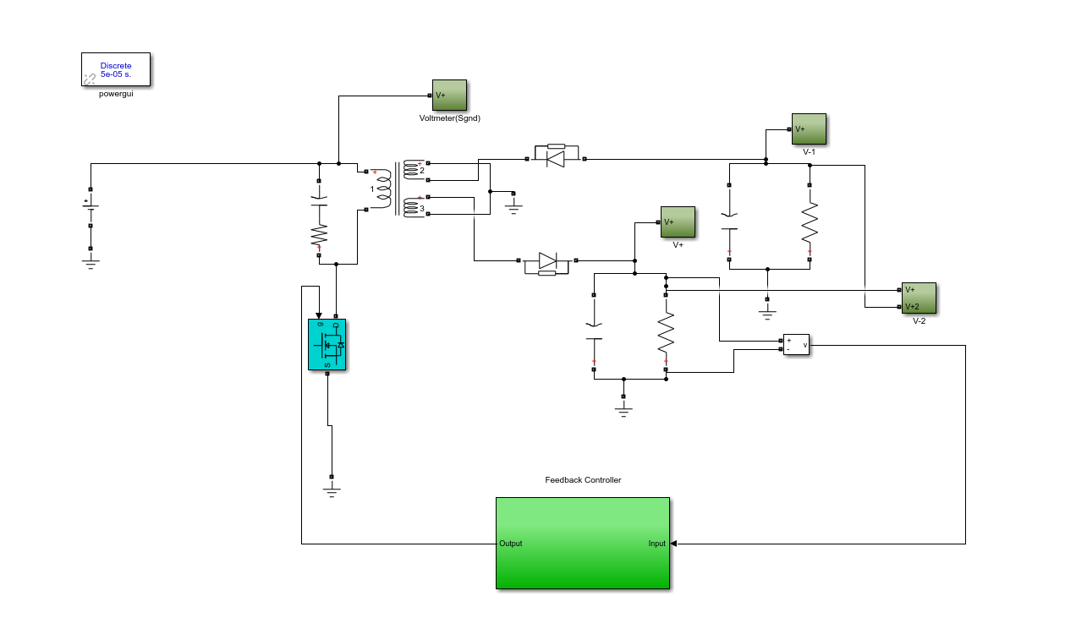
Fuzzy Logic Implementation
In our implementation the we measure the output voltage and then compare it with the reference value
The Controller then drives the mosfet and regulates the output, in order to minimize the error
Figure 1. Flyback Converter with Fuzzy Logic Controller
Basic Principles of Power Electronics
Supervisor: Professor Nikolaos Papanikolaou
Notes:
To keep the output voltage of an FC system regulated as necessary for modern electronic devices irrespective of the changes in input voltage or load current, an ANFIS-based controller was proposed in this research.
A FIS structure containing 25 fuzzy rules (in our case) relating the inputs and the output originally generated by the fuzzy logic system was tuned by ANFIS.
It was observed that the FIS tuned by ANFIS exhibited better output voltage response under static and transient loads. Better set-point tracking was also achieved. ANFIS may utilize past results or experiences to make immediate decisions about the response. Training of fuzzy rules by ANFIS made the ANFIS-based controller more adaptive. Simulation results depicted that both the static and dynamic performance of the ANFIS-based controller was better in all aspects compared to the FLC and PID controllers. Hardware implementation of the proposed compensated system can be carried out in future.

Slide 24
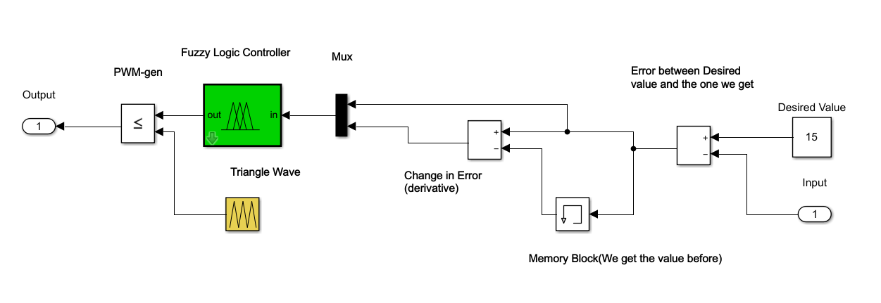
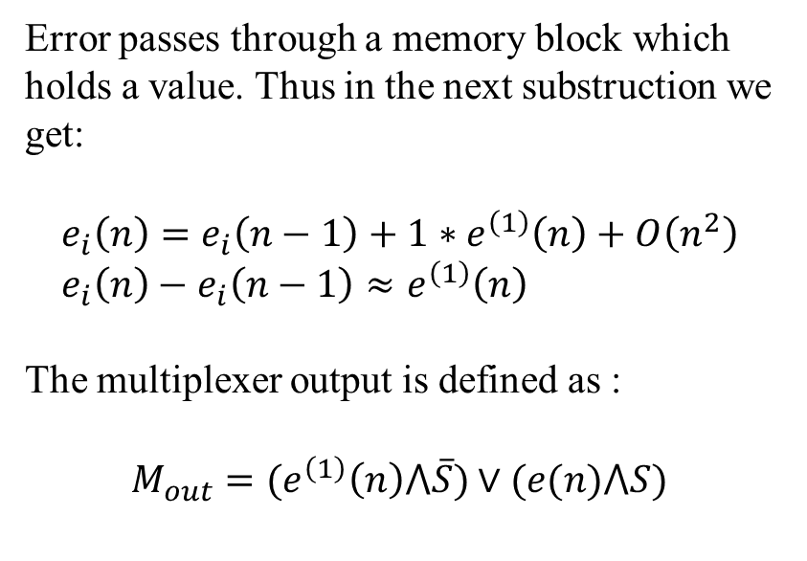
Fuzzy Logic Implementation
Error passes through a memory block which holds a value. Thus in the next substruction we get:
$$e_{i}\left(n\right)=e_{i}\left(n−1\right)+1∗e^{\left(1\right)}\left(n\right)+O\left(n^{2}\right) \\ e_{i}\left(n\right)−e_{i}\left(n−1\right)≈e^{\left(1\right)}\left(n\right)$$
The multiplexer output is defined as :
$$M_{out}=(e^{\left(1\right)}\left(n\right)⋀\overline{S})∨(e(n)⋀S)$$
Figure 1. Controller Block Diagram
Basic Principles of Power Electronics
Supervisor: Professor Nikolaos Papanikolaou
Notes:
To keep the output voltage of an FC system regulated as necessary for modern electronic devices irrespective of the changes in input voltage or load current, an ANFIS-based controller was proposed in this research.
A FIS structure containing 25 fuzzy rules (in our case) relating the inputs and the output originally generated by the fuzzy logic system was tuned by ANFIS.
It was observed that the FIS tuned by ANFIS exhibited better output voltage response under static and transient loads. Better set-point tracking was also achieved. ANFIS may utilize past results or experiences to make immediate decisions about the response. Training of fuzzy rules by ANFIS made the ANFIS-based controller more adaptive. Simulation results depicted that both the static and dynamic performance of the ANFIS-based controller was better in all aspects compared to the FLC and PID controllers. Hardware implementation of the proposed compensated system can be carried out in future.

Slide 25
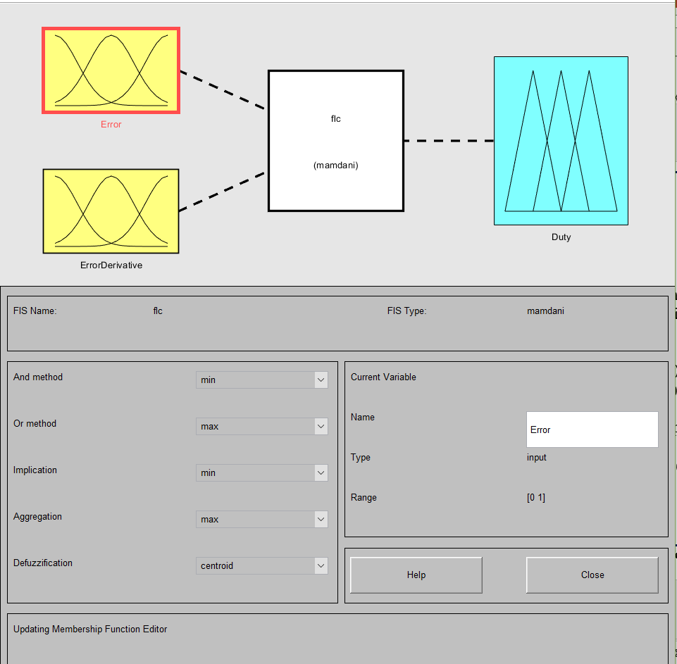
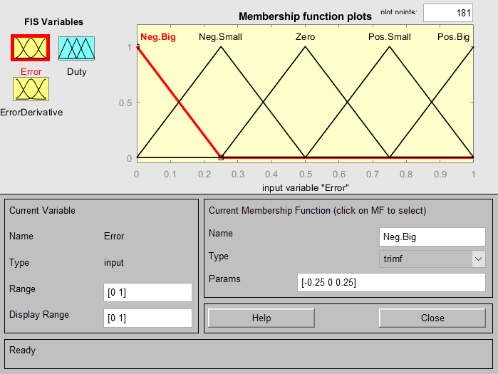
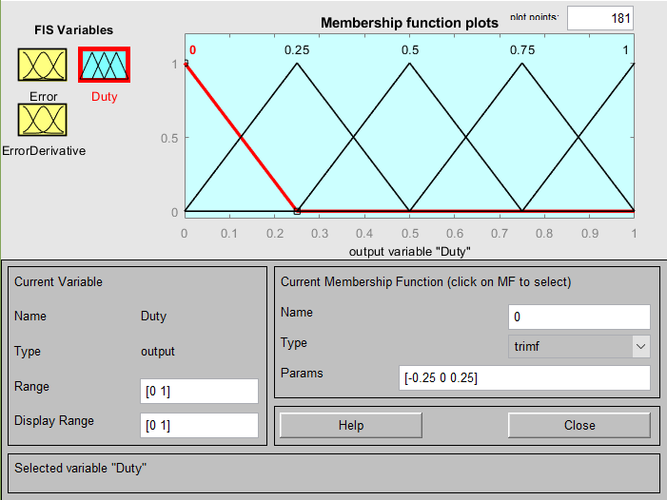
Fuzzy Logic Implementation
Figure 1. Fuzzy Logic Block, input, output.
Basic Principles of Power Electronics
Supervisor: Professor Nikolaos Papanikolaou
Notes:
To keep the output voltage of an FC system regulated as necessary for modern electronic devices irrespective of the changes in input voltage or load current, an ANFIS-based controller was proposed in this research.
A FIS structure containing 25 fuzzy rules (in our case) relating the inputs and the output originally generated by the fuzzy logic system was tuned by ANFIS.
It was observed that the FIS tuned by ANFIS exhibited better output voltage response under static and transient loads. Better set-point tracking was also achieved. ANFIS may utilize past results or experiences to make immediate decisions about the response. Training of fuzzy rules by ANFIS made the ANFIS-based controller more adaptive. Simulation results depicted that both the static and dynamic performance of the ANFIS-based controller was better in all aspects compared to the FLC and PID controllers. Hardware implementation of the proposed compensated system can be carried out in future.

Slide 26
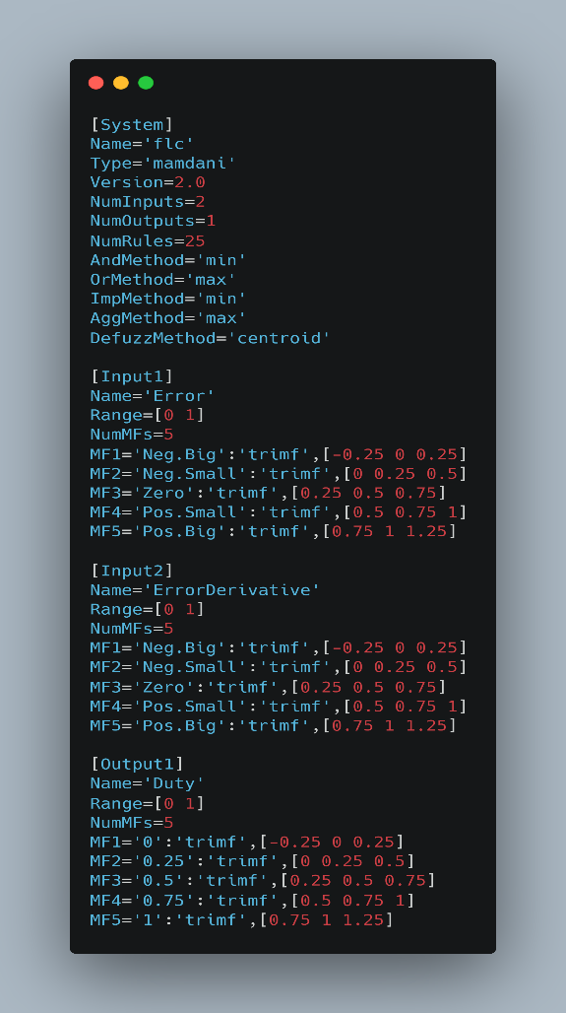
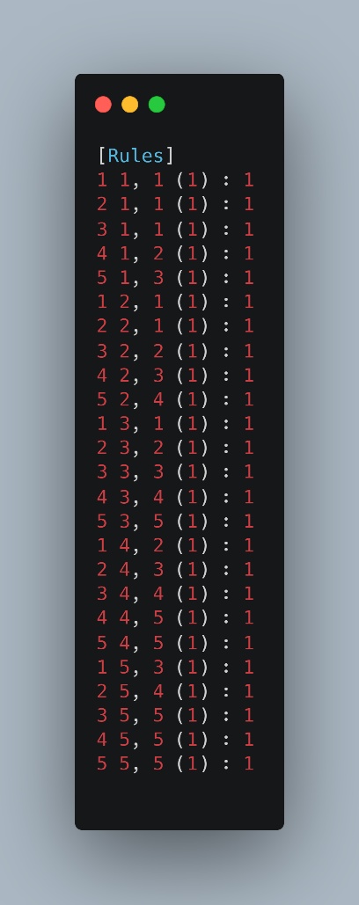
Fuzzy Logic Implementation
Δe\e | Neg. Big | Neg. Small | Zero | Pos. Small | Pos. Big
Neg. Big | 0 | 0 | 0 | 0.25 | 0.5
Neg. Small | 0 | 0 | 0.25 | 0.5 | 0.75
Zero | 0 | 0.25 | 0.5 | 0.75 | 1
Pos. Small | 0.25 | 0.5 | 0.75 | 1 | 1
Pos. Big | 0.5 | 0.75 | 1 | 1 | 1
Figure 1. Rules for the FLC.
Figure 1. Fuzzy Logic Block code
Basic Principles of Power Electronics
Supervisor: Professor Nikolaos Papanikolaou
Notes:
To keep the output voltage of an FC system regulated as necessary for modern electronic devices irrespective of the changes in input voltage or load current, an ANFIS-based controller was proposed in this research.
A FIS structure containing 25 fuzzy rules (in our case) relating the inputs and the output originally generated by the fuzzy logic system was tuned by ANFIS.
It was observed that the FIS tuned by ANFIS exhibited better output voltage response under static and transient loads. Better set-point tracking was also achieved. ANFIS may utilize past results or experiences to make immediate decisions about the response. Training of fuzzy rules by ANFIS made the ANFIS-based controller more adaptive. Simulation results depicted that both the static and dynamic performance of the ANFIS-based controller was better in all aspects compared to the FLC and PID controllers. Hardware implementation of the proposed compensated system can be carried out in future.

Slide 27
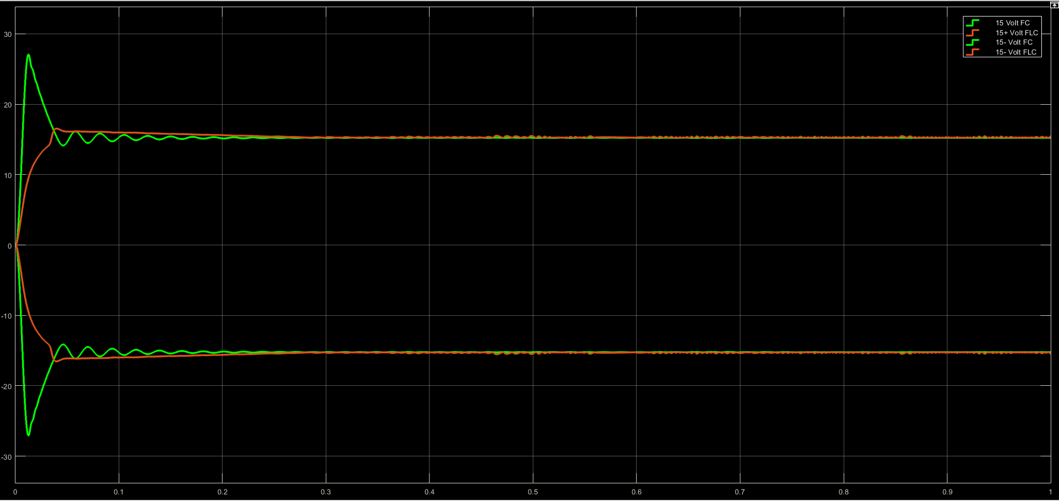
Fuzzy Logic Implementation
FC and FLC controllers are being monitored. The results show that the FLC block is effective in decreasing
Overshoot and reducing settling time drastically
Figure 1. Fuzzy Logic and regular PI output
Basic Principles of Power Electronics
Supervisor: Professor Nikolaos Papanikolaou
Notes:
To keep the output voltage of an FC system regulated as necessary for modern electronic devices irrespective of the changes in input voltage or load current, an ANFIS-based controller was proposed in this research.
A FIS structure containing 25 fuzzy rules (in our case) relating the inputs and the output originally generated by the fuzzy logic system was tuned by ANFIS.
It was observed that the FIS tuned by ANFIS exhibited better output voltage response under static and transient loads. Better set-point tracking was also achieved. ANFIS may utilize past results or experiences to make immediate decisions about the response. Training of fuzzy rules by ANFIS made the ANFIS-based controller more adaptive. Simulation results depicted that both the static and dynamic performance of the ANFIS-based controller was better in all aspects compared to the FLC and PID controllers. Hardware implementation of the proposed compensated system can be carried out in future.

